Slide 1


Adventures
In
Auto Insurance
Created by Oregon’s Department of Consumer and Business Services, Insurance Division.

Slide 2

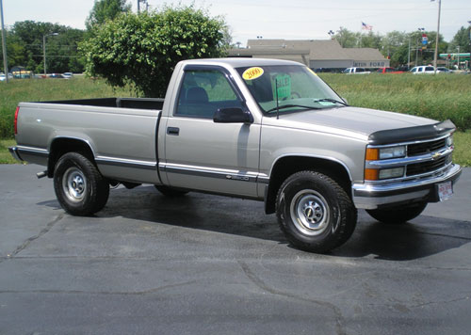


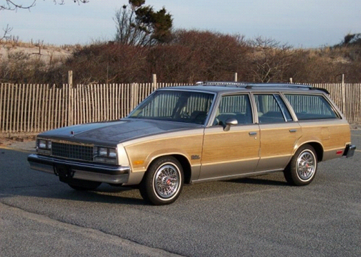
Buy your Car
A
B
$50,000
$10,000
$1,000
$25,000
C
D

Slide 3
$50,000
You will need to make $750 monthly payments for 5 years
Your bank will make you buy really good insurance until you pay it off.
Make a $10,000 down payment

Slide 4

$25,000
You will need to make $375 monthly payments for 5 years
Your bank will make you buy really good insurance until you pay it off.
Make a $5,000 down payment

Slide 5
$10,000
You are able to pay cash for this
You can buy however much insurance you want
Pay $10,000

Slide 6
$1,000
You are able to pay cash for this
You can buy however much insurance you want
Pay $1,000

Slide 7
Let’s buy insurance!
(Optional)
Required by Banks
Required Coverage
Bodily injury liability
$180
Uninsured motorist property
$10
Property damage liability
$60
Collision
$70
Personal injury protection (PIP)
$60
Comprehensive
$10
Uninsured motorist bodily injury
$10

Slide 8


Add up your coverage
This is your monthly payment and your premium
$750: Car payment
+$400: Insurance
$1,150: A month
$375: Car payment
+$400: Insurance
$775: A month

Slide 9


Add up your coverage
This is your monthly payment (your premium)
$0: Car payment
+$310: Insurance
$310: A month
$0: Car payment
+$310: Insurance
$310: A month

Slide 10
What’s your deductible?
How much do you want to pay if you are in an accident?
$250 deductible
Add $100 to your premium
$500 deductible
Add $50 to your premium
$1,000 deductible
Add $25 to your premium

Slide 11



Land on a Odd
Number Bad
Things Happen
1
3
5
7
9
Land on a Even Number Good Things Happen
0
2
4
6
8
Finished

Slide 12



0
0
You Completed a Driver’s Education Course
You can deduct $50 from
your Monthly Premiums
0
0

Slide 13
2
2
You have improved your
Credit Score
You can deduct $50 from
your Monthly Premiums
2
2

Slide 14
4
4
You are a good Student
You can deduct $100 from
your Monthly Premiums
4
4

Slide 15
6
6
You Don’t Text while Driving
You can deduct $100 from
your Monthly Premiums
6
6

Slide 16
8
8
You maintain a clean
driving record
You can deduct $100 from
your Monthly Premiums
8
8

Slide 17

1
1
You text while driving
You add $100 to your
Monthly Premiums
1
1

Slide 18
3
3
You hit a parked car
Pay $200 and/or your deductible
250 / 500 / 1,000
3
3

Slide 19
5
5
You were ticketed
for speeding
You add $50 to your
Monthly Premiums
5
5

Slide 20
7
7
You forgot to use
your seatbelt
You add $50 to your
Monthly Premiums
7
7

Slide 21
9
9
You Ran a Red Light
You add $50 to your
Monthly Premiums
9
9

Slide 22



How did you do?
How much money did you end up spending?
What caused you to spend as much as you did?

Slide 23

If you need help with your insurance,
contact an Oregon Insurance Division consumer advocate.
We speak insurance. We'd like to help.
www.insurance.oregon.gov

